Slide 1

Final Project Presentation
IN Pipe Inspection Robot
AMAL MATHEW THOMAS - 14
AVINAS SUMESH - 22
GOUTHAM KRISHNA - 32
NABIL N | 46
V SIVASANKAR | 66
ELECTRICAL AND ELECTRONICS, SAINTGITS COLLEGE OF ENGINEERING

Slide 2
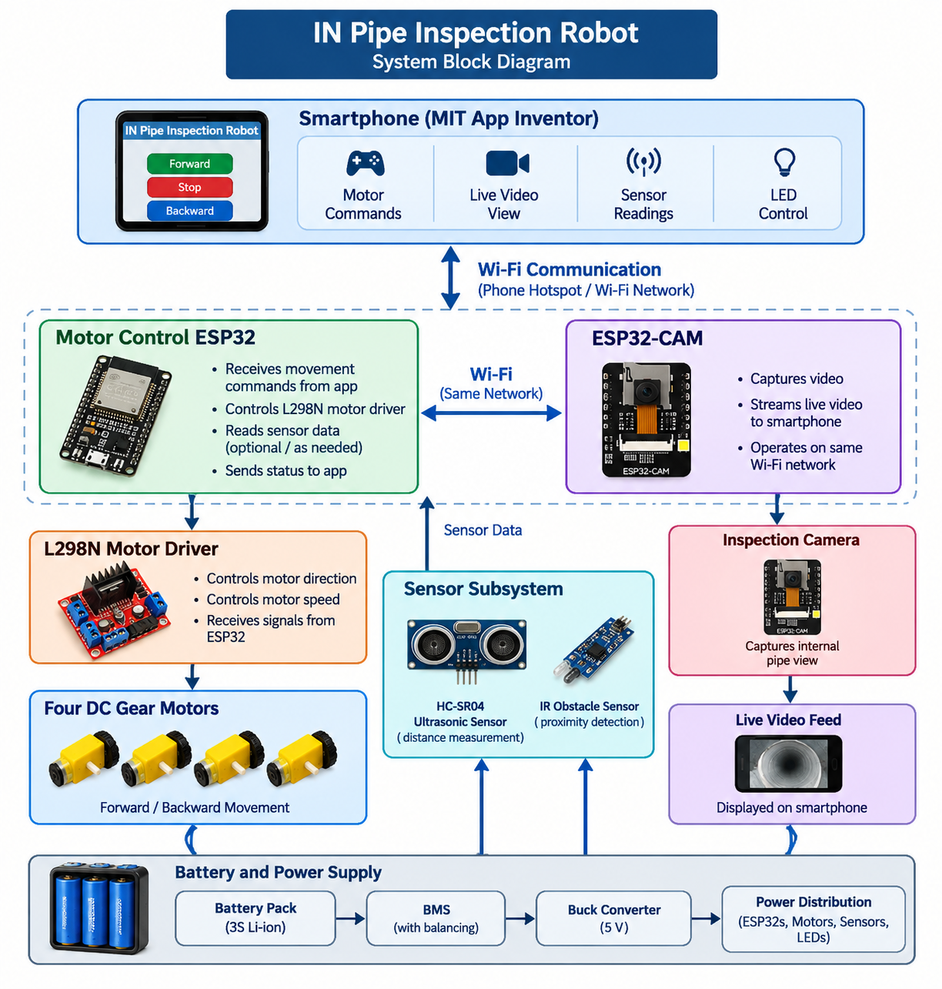
System Architecture

Slide 3
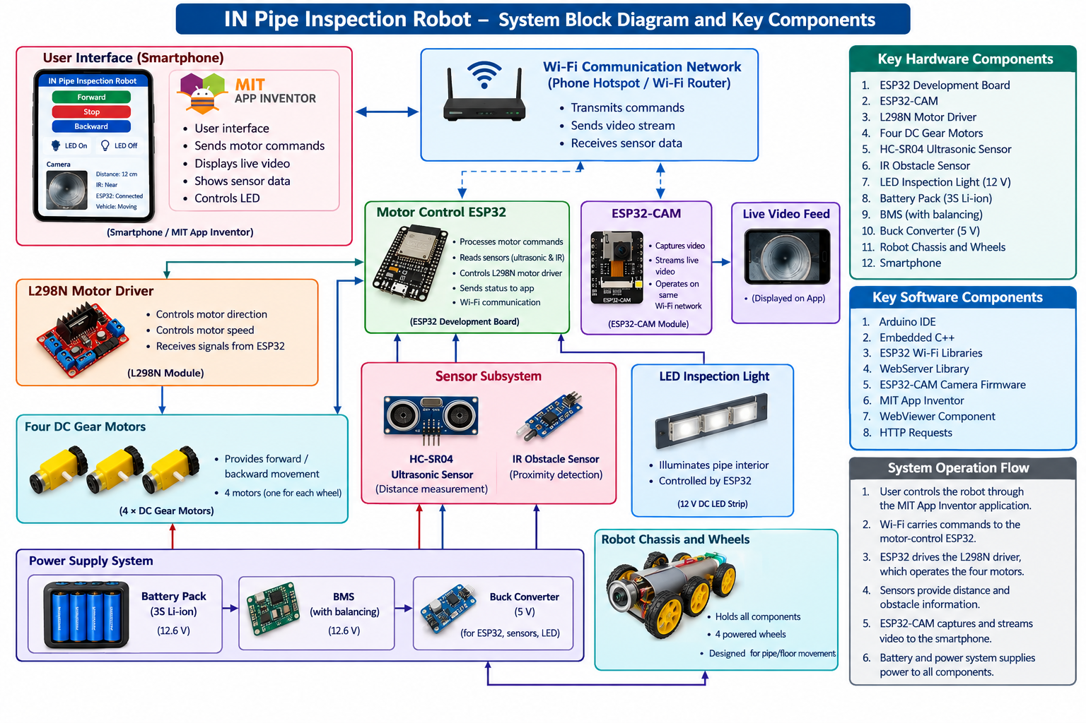
System Architecture

Slide 4
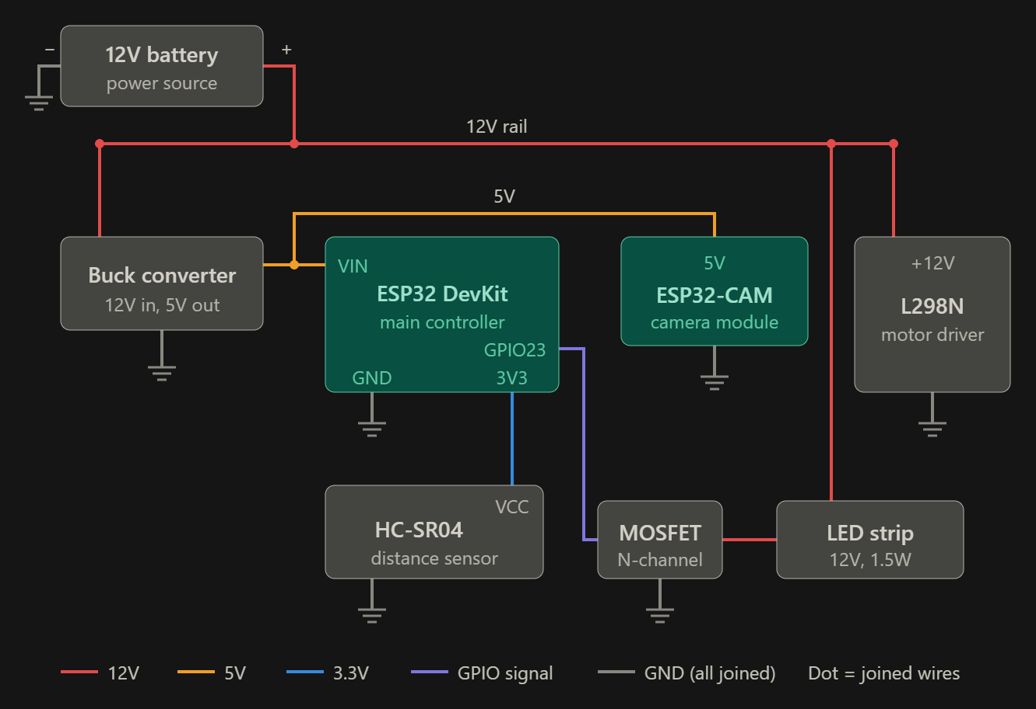
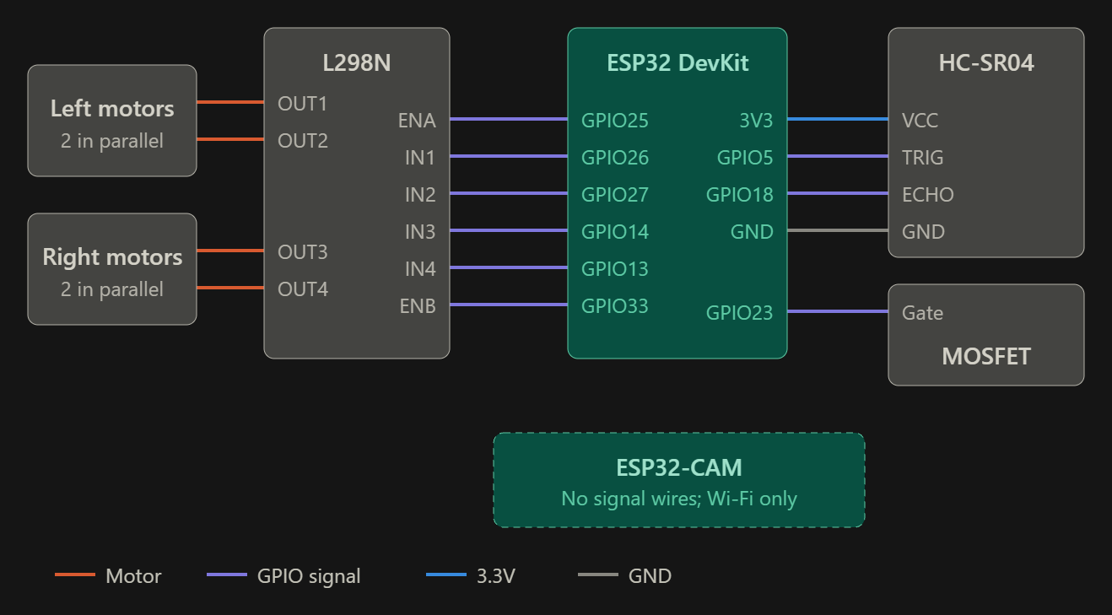
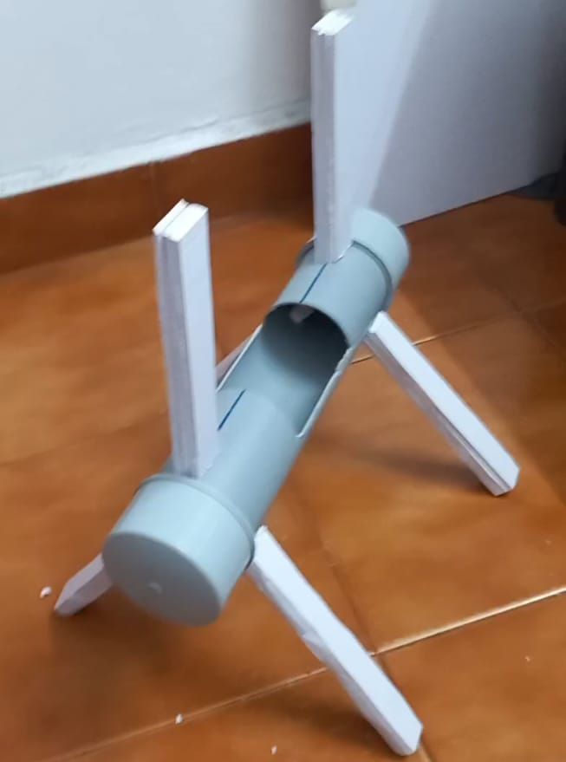
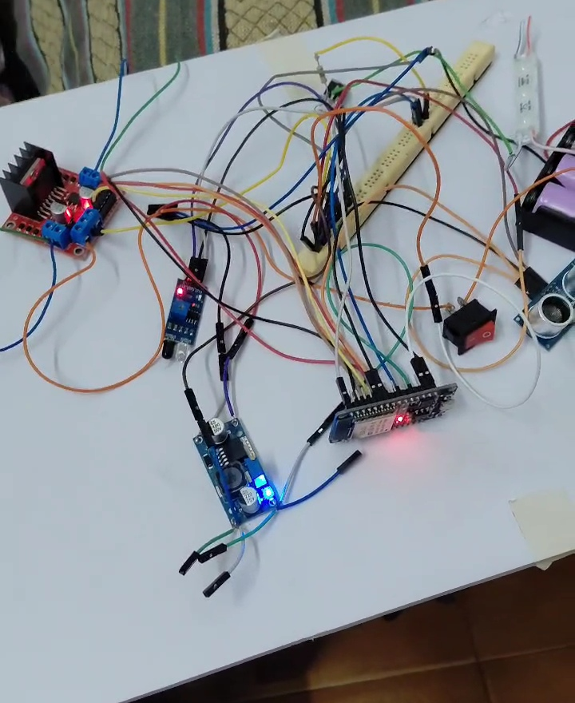
Implementation
CIRCUIT DIAGRAM:
HARDWARE SETUP :

Slide 5
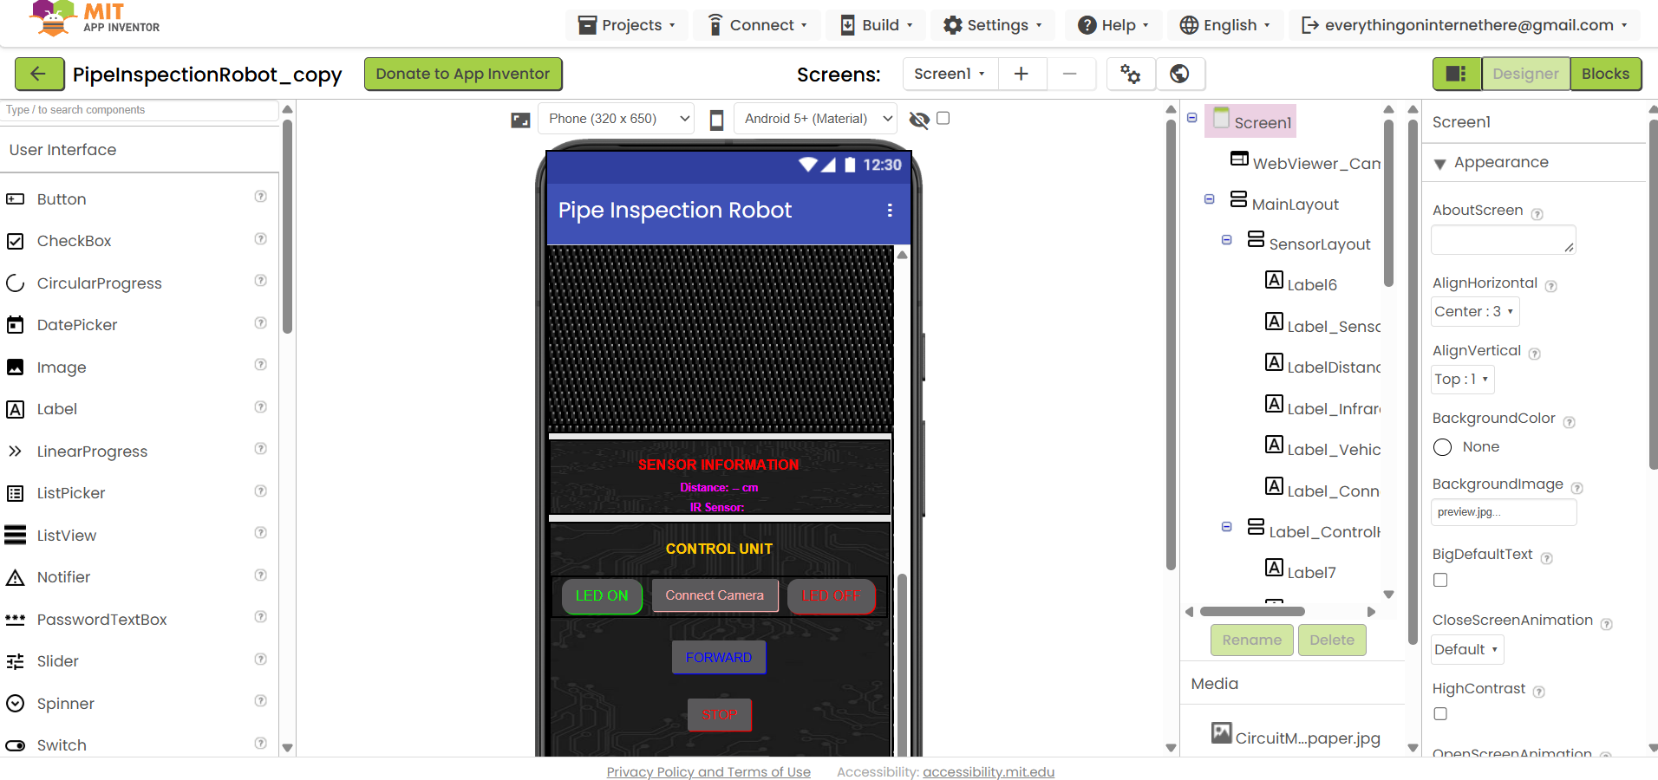
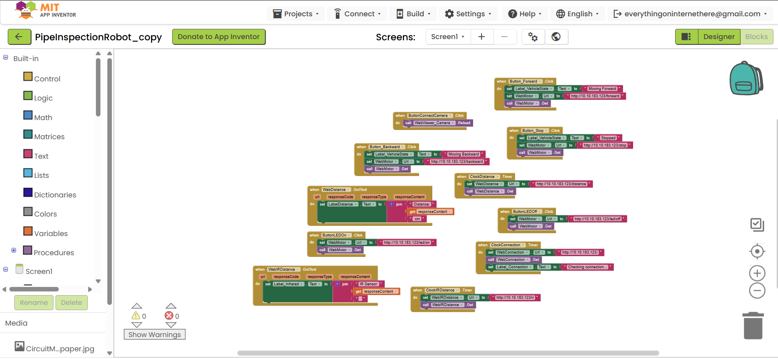
Implementation
MIT APP INVENTOR:
DESIGNER:
BLOCKS:

Slide 6
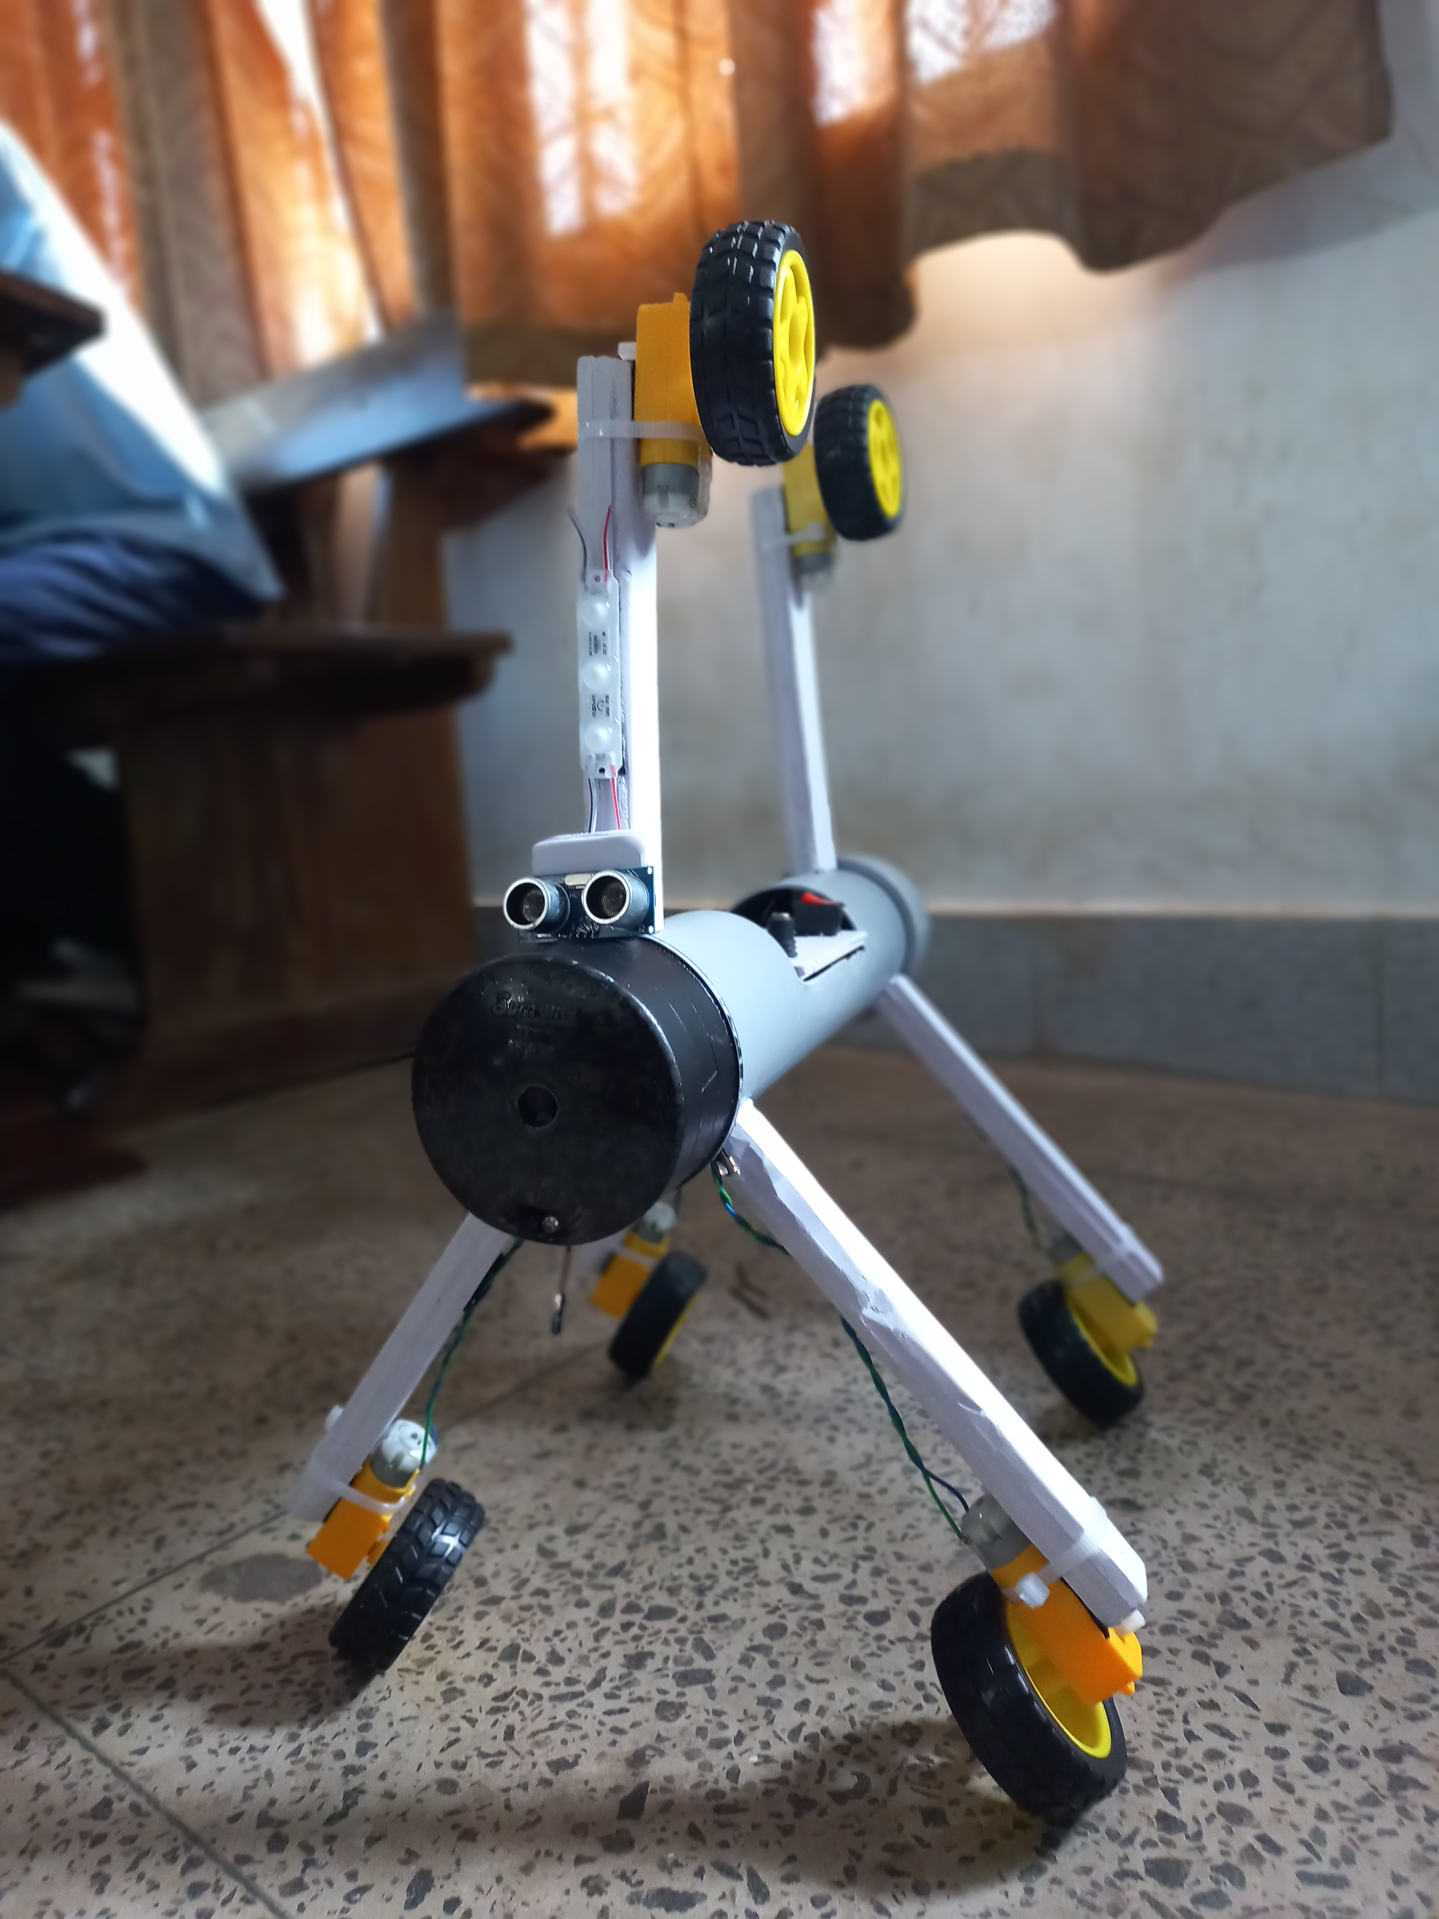
Experimental Setup
setup photographs :

Slide 7
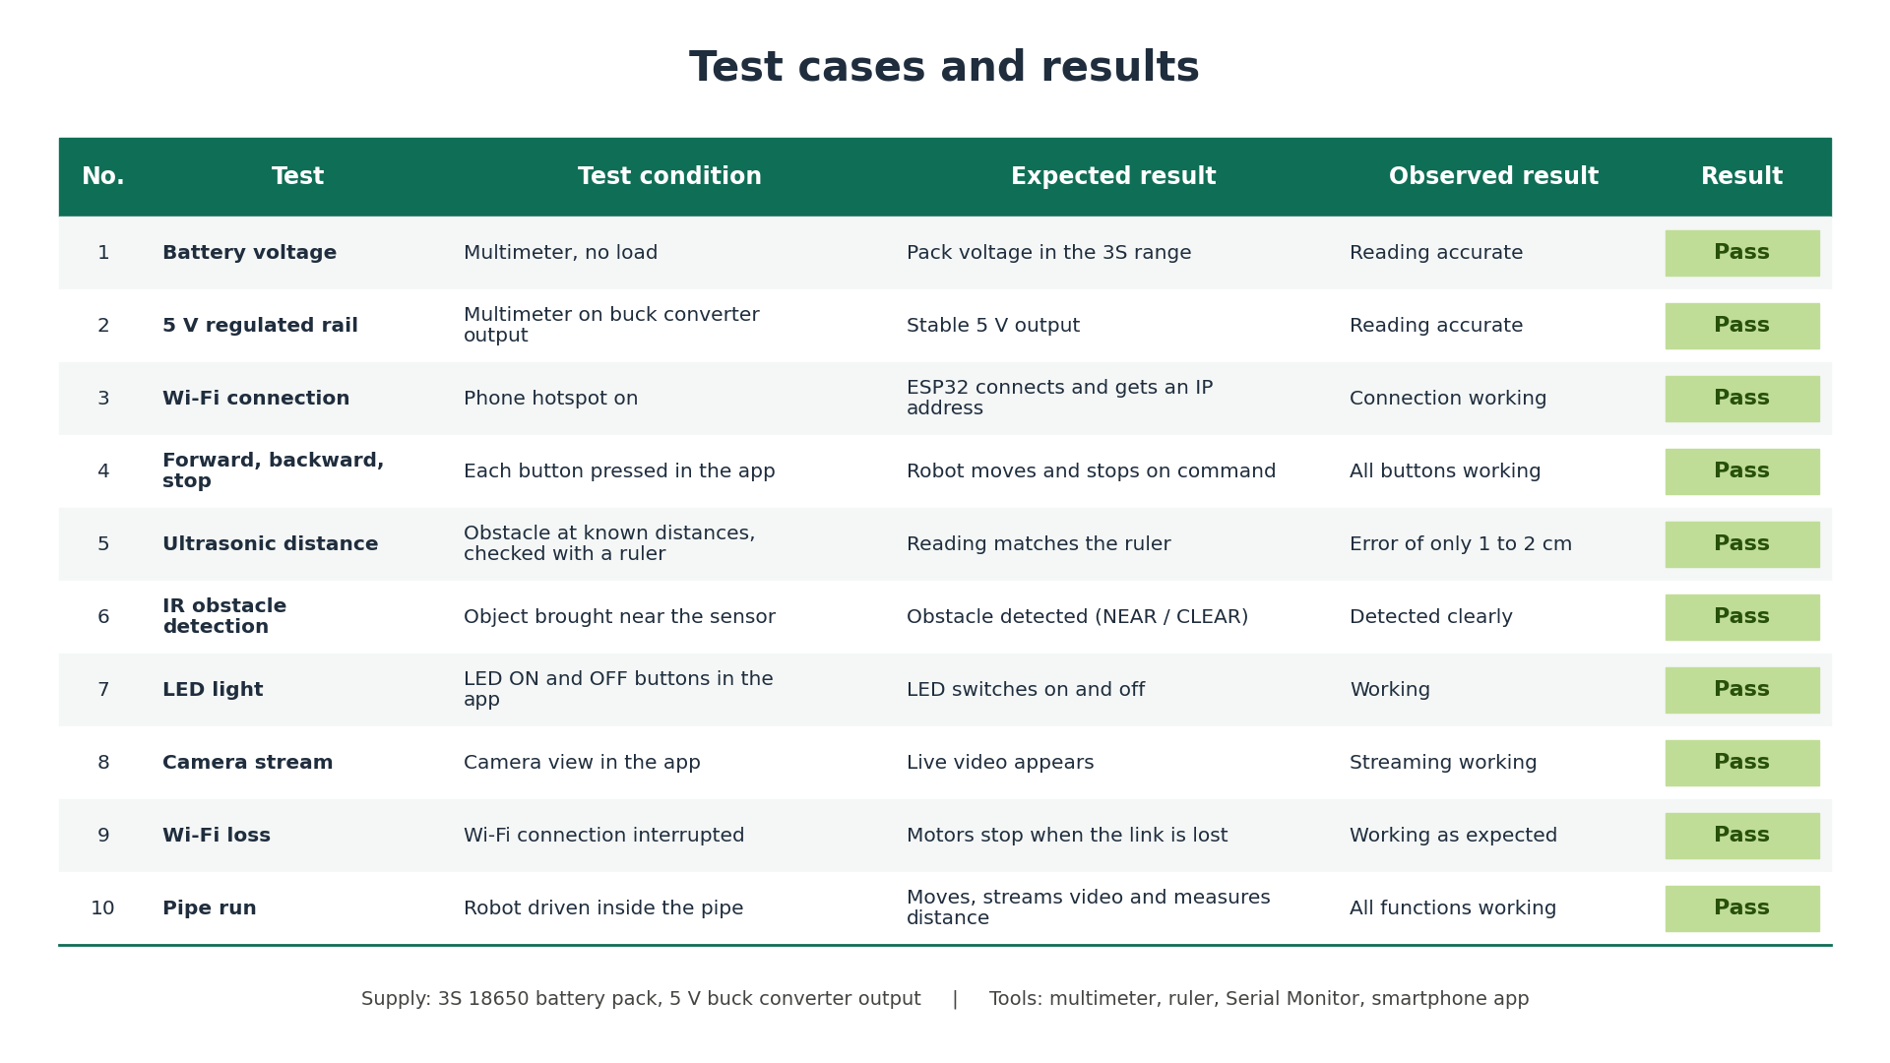
Experimental Setup

Slide 8
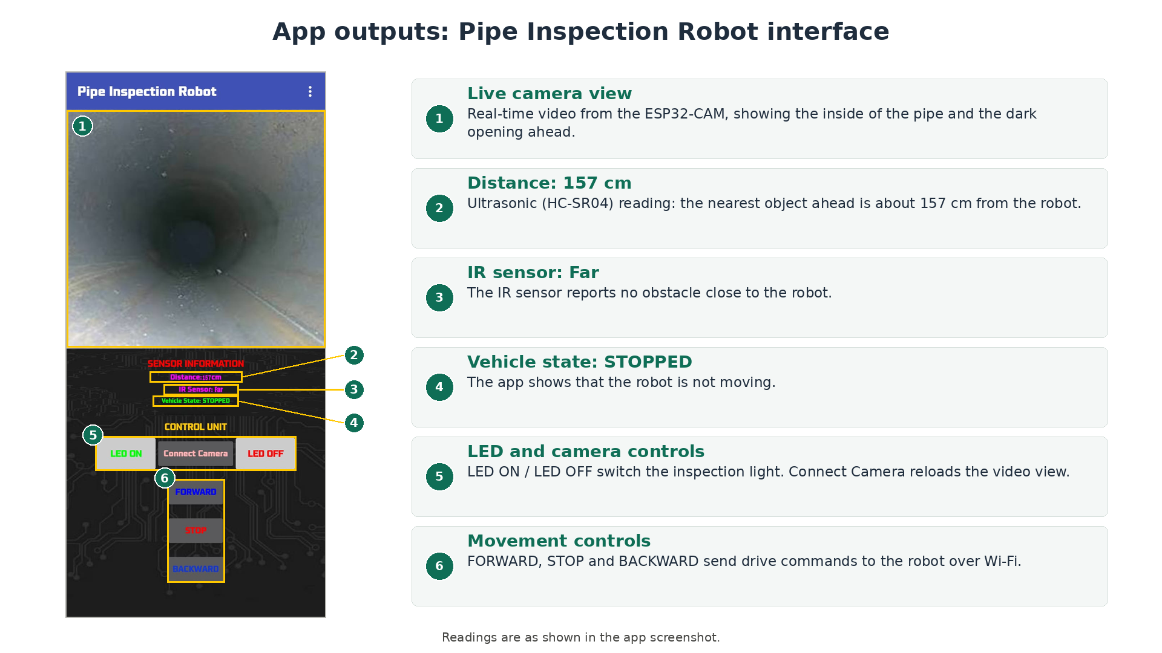
Results & Analysis

Slide 9
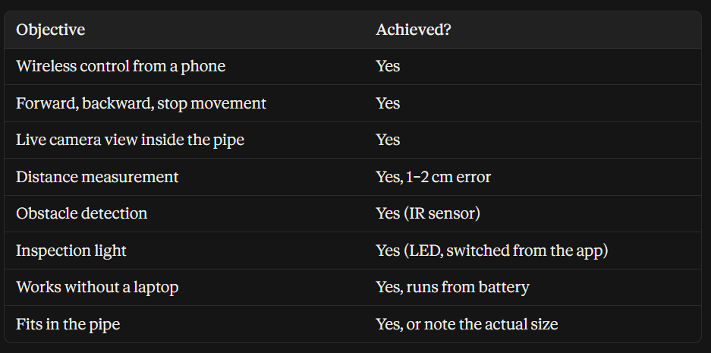
Results & Analysis

Slide 10
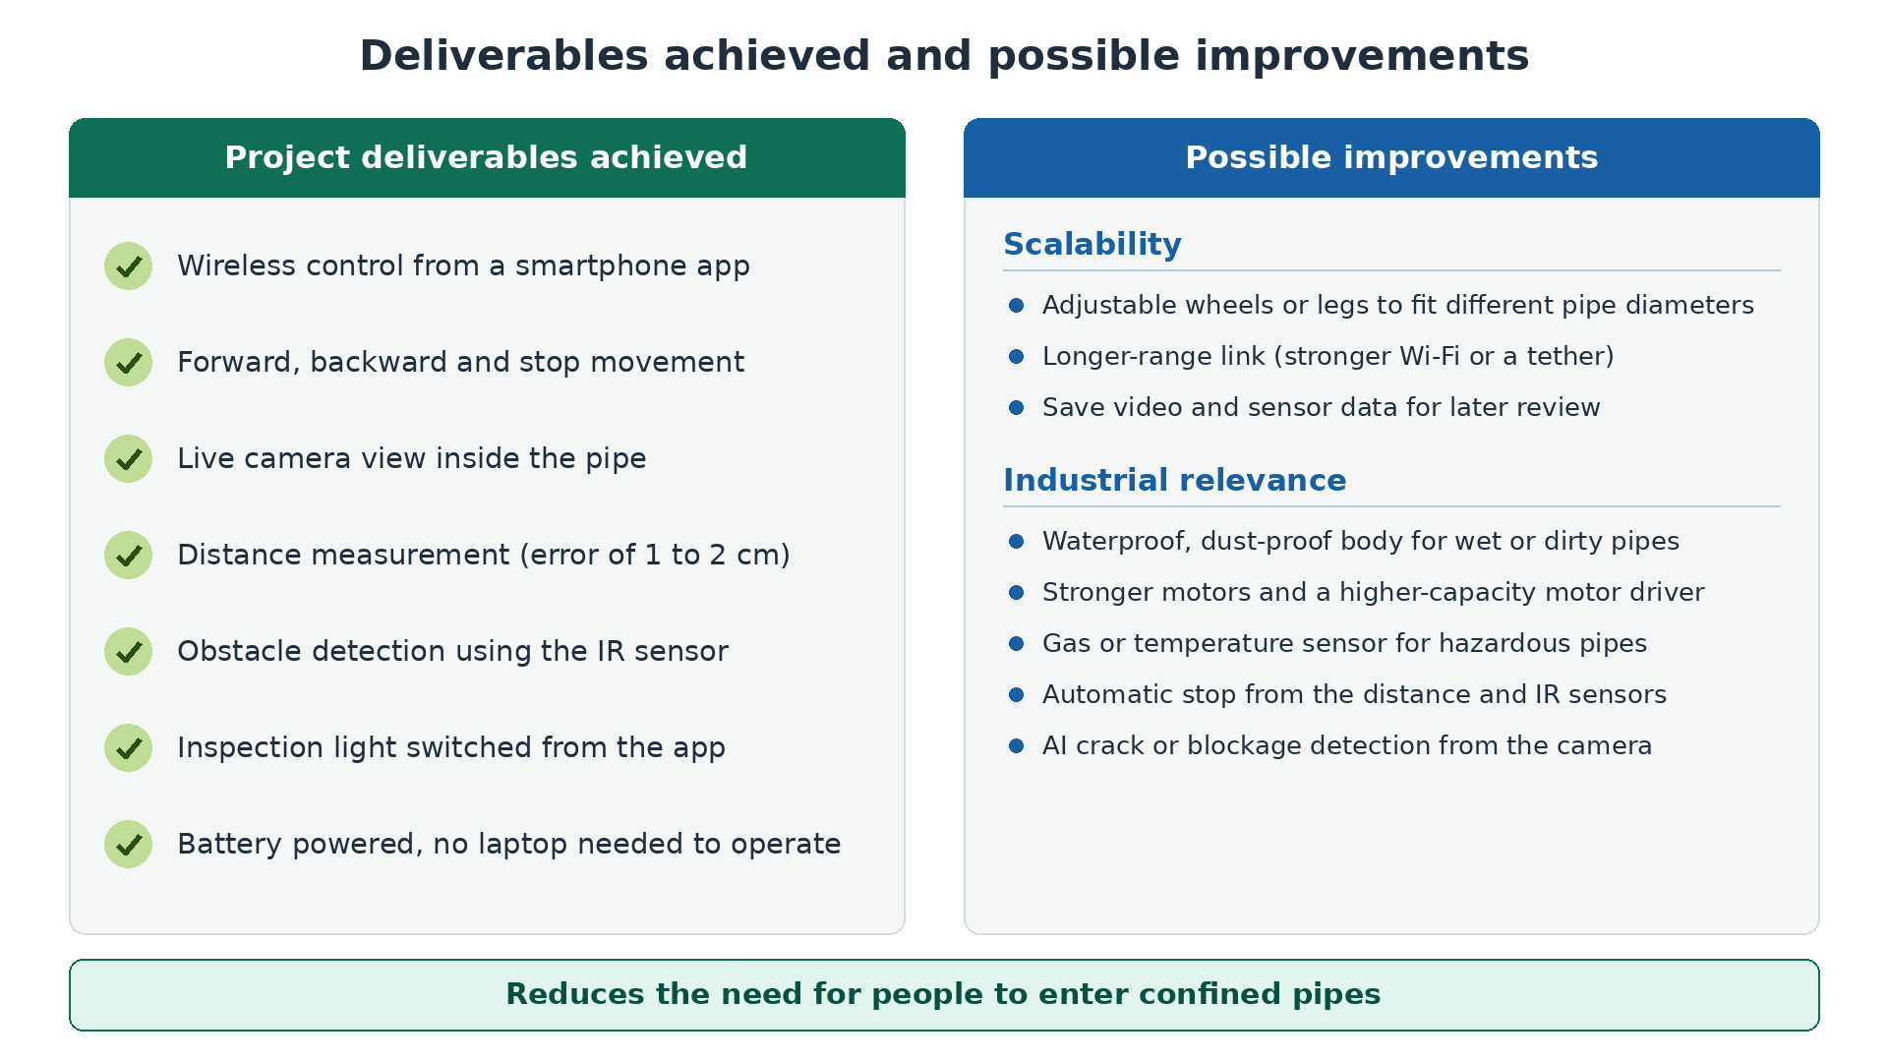
Conclusion & Future Scope

